Slide 1
Classifying Stellar Spectra
By Edith Johnston
Notes:
I chose this project in large part just because I think stars and astrophysics are really really cool, and I wanted to try working with this kind of data.

Slide 2
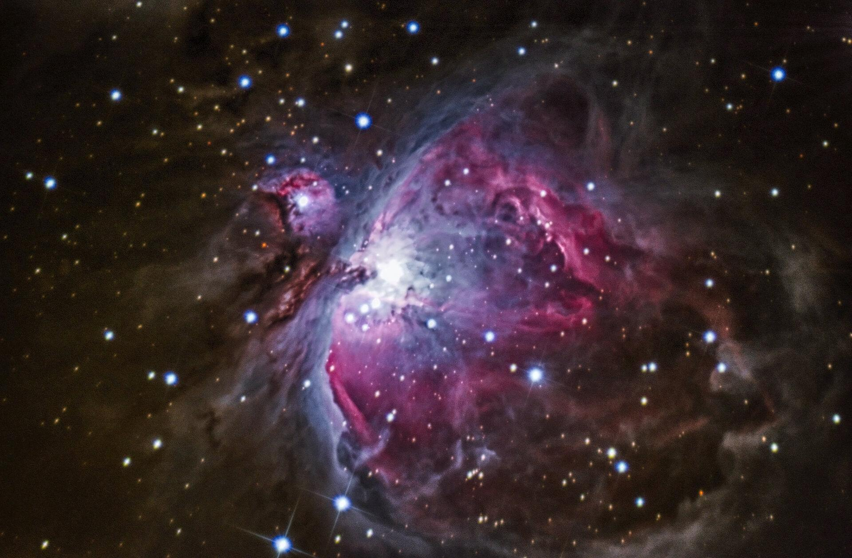
Table of Contents
Science Intro
Data and Model
Model Performance
Next Steps
Notes:
Before getting into the project details, just in case not everyone in the audience has a degree in astrophysics, let me briefly overview the science of this project
First, the target class I was attempting to predict is what’s called Morgan-Keenan spectral types, which look a little something like this >>>

Slide 3
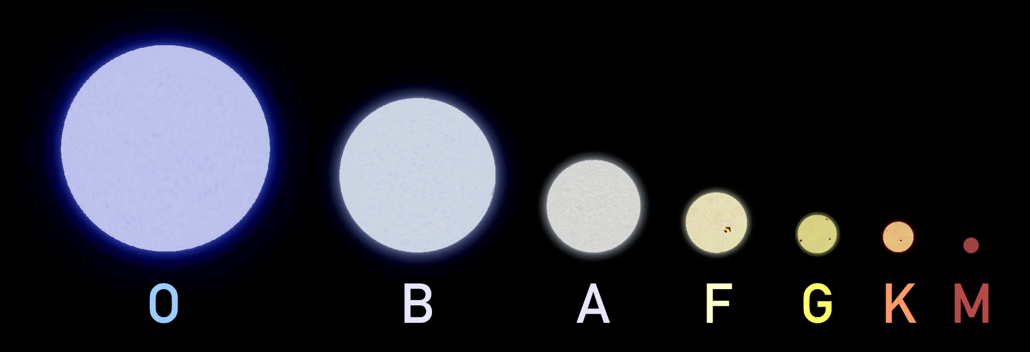
Stellar Spectral Types
Our Sun
Notes:
These spectral types are essentially a means to group stars with similar characteristics such as mass and temperature
These characteristics strongly affect color - think about how a candle flame is blue in the center, at the hottest part
So in order to determine type, astronomers look at… >>>

Slide 4
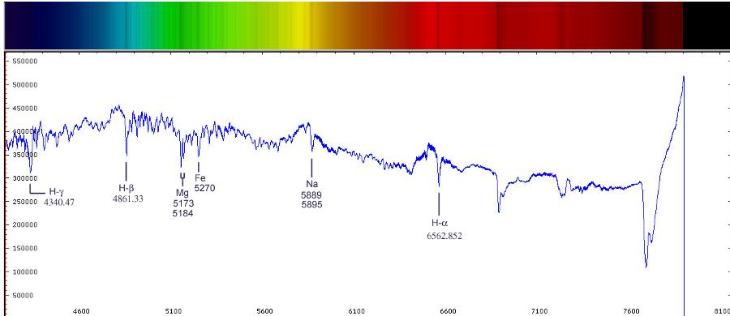
Stellar Spectra
Notes:
...the spectrum of visible light coming from by star as in this colored bar here
Then they record the intensity of light according to wavelength, which looks like this >>>
The features of my data are estimates of this intensity at a series of specific line indices
Now at this point, you might be asking yourself… >>>

Slide 5
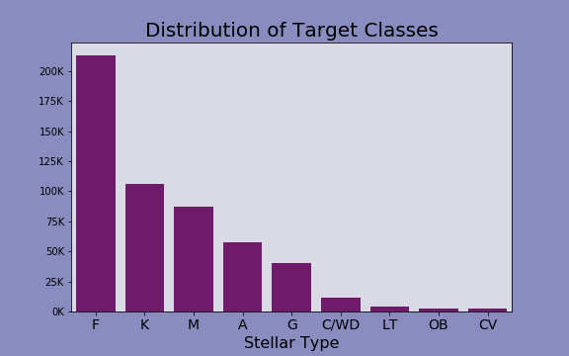
Class Distribution
Largest 5 Classes: Random Undersampling
Smallest 4 Classes: Random Oversampling
Notes:
Before modelling, I needed to check out the distribution my target classes >>>
Plot shows distribution of spectral types in my data - as you can see, it’s super imbalanced!
To correct this I ended up doing two things: >>>
1st, I undersampled large classes >>>
then oversampled small classes to get a uniform quantity of 10k samples for every class

Slide 6
Model
Histogram-based
Gradient Boosting
Classification Tree
Advantages of This Model:
Scales well to more features
NaN handling
Faster for large sample sizes
Notes:
After trying out a number of models, I ended up using this model >>>
Histogram-based gradient boosting is a fairly new model, so for those of you unfamiliar with it, this model is an experimental model in sklearn that uses histogram binning to reduce features down to discrete ranges rather than a continuous spectrum, which vastly speeds up decision splitting. >>>
As a result, it scales really well to large numbers of features, which was helpful for me given that my data had 340 feature columns >>>
It also has integrated nan handling, which treats nans essentially as a categorical variable integrated with the continuous features. This was really helpful given that some of the NaNs in my data represented data too noisy to accurately determine rather than missing data, which could potentially be a helpful aspect of the feature. >>>
Additionally, this model also tends to be faster than other tree based ensemble models when dealing with large sample sizes.
In the end, this model outperformed every other model I tried (including xgboost), and was indeed faster than the other tree based ensemble models i tried >>>

Slide 7
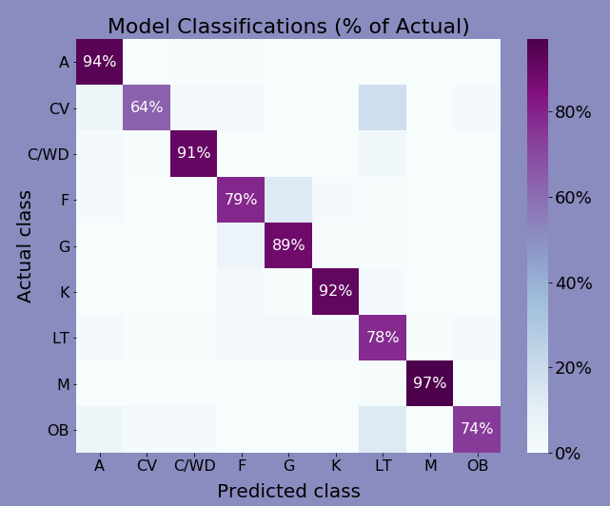
Model
Performance
Balanced accuracy
score:
0.85
Minority classes
Correct classifications are on the diagonal
Notes:
Speaking of performance, I used a couple of metrics to determine model success. My goal was basically to get the best accuracy rate I could for each and every class, so when I needed a single score metric, >>> I used balanced accuracy score. Since that’s an unweighted mean of class accuracies, it places more value on accuracy across all classes rather than across all samples, thus compensating for class imbalance.
However, I have a lot of classes and I was wary of using a single number to represent them all. Even with the metric compensating somewhat for imbalance, really good scores in majority classes will still sometimes cover up poorer scores in minority classes.
So to get more detail, through the modelling process, I mapped the confusion matrix normalized by true class, like so >>>
With the correct classifications on the diagonal, this plot makes it pretty easy to see at a glance how well the model performed for each class >>>
As you can see, for the most part this model did as well for my minority classes as for the others.
However, there’s a lot more I would like to add to or change about this model before considering it ready for an automation process

Slide 8
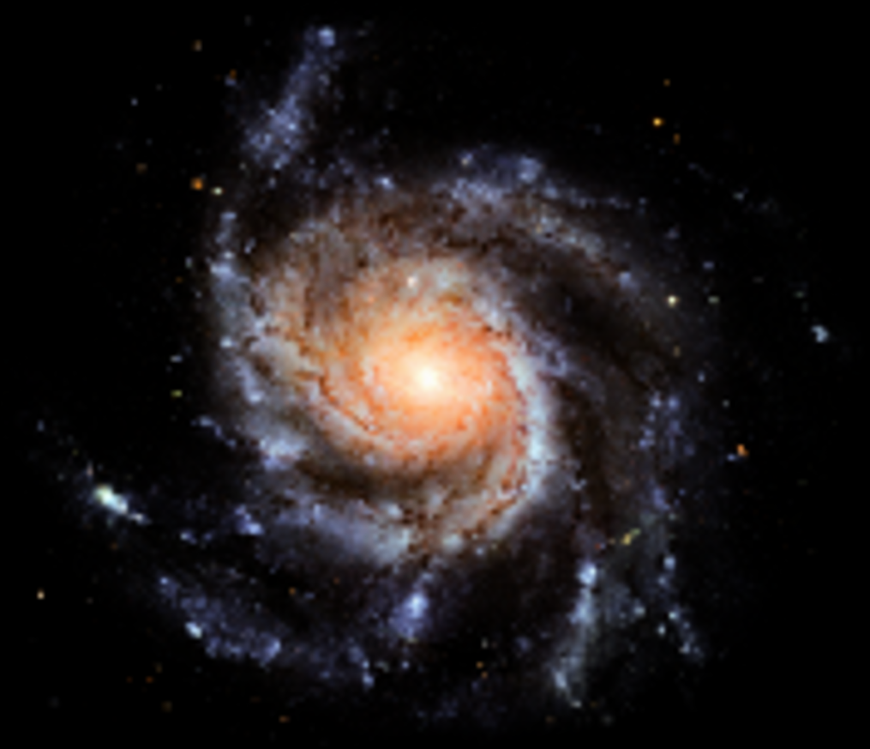
Next Steps
Adding Capability
Improving Performance
Subclasses
Non-stellar objects
Galaxies
Quasars
Data from other sources
Train iteratively with resampled data
Notes:
To start with, I would like to expand capability >>>
By dividing stellar types into subclasses, which are >>>
and adding in non stellar objects >>>
such as galaxies, >>> quasars, and more >>>
Additionally, I would like to improve performance and validity of my model in a couple ways >>>
One, by branching out my training data sources >>>
And two, since I took a significant subsample of my data, I would like to iteratively retrain the model on different random states of under and oversampling to get a more thorough view of the data. >>>

Slide 9
Thank You
For Your Time
Project by: Edith Johnston
Github repository: https://github.com/edithalice/stellar_classification
LinkedIn: www.linkedin.com/in/edith-johnston
Notes:
That concludes
Thank you

Slide 10
The Fine Print
This research makes use of the SciServer science platform (www.sciserver.org).
SciServer is a collaborative research environment for large-scale data-driven science. It is being developed at, and administered by, the Institute for Data Intensive Engineering and Science at Johns Hopkins University. SciServer is funded by the National Science Foundation through the Data Infrastructure Building Blocks (DIBBs) program and others, as well as by the Alfred P. Sloan Foundation and the Gordon and Betty Moore Foundation.

Slide 11
Appendix

Slide 12
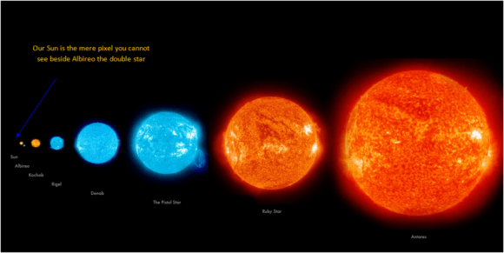
What’s the Point of Classifying?
Different behavior
Filtering searches
Potentially habitable planets can be found orbiting F or G stars
My Project Goal
Too many stars!
⇩
Automation
Notes:
What’s the point? Well one big reason is that >>>
Different types lead different lives and behave differently
A large blue O type star might live less than 10 thousand years and then implode into a black hole, whereas an M type red dwarf might last trillions of years before slowly dying out >>>
Additionally, stellar type makes a good filter when searching for stars that meet specific criteria
For example, if you’re looking for habitable planets >>>
Look at F and G stars
However
Given that astronomers determine stellar type by looking at spectra, why model it? >>>
Well the trouble is, >>>
there’s as much data as there are stars in the sky, and there’s just not enough time to classify them all manually
So >>> >>> i want to automate the process.

Slide 13
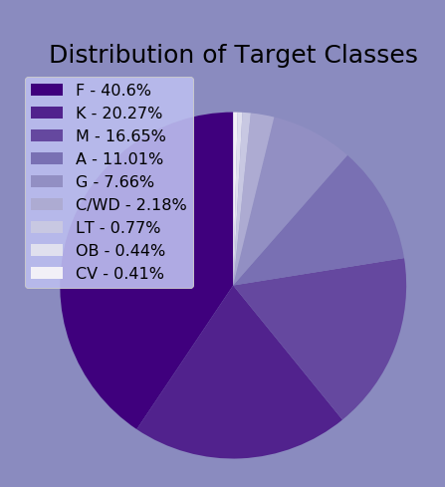
Data Structure
Features
Target
Data Source:
Sloan Digital Sky Survey
71 features with 4 sub features each
Each feature represent elemental line index
Sub features: global continuum fit, local value fit, error, pixel quality mask
Initially, 21 classes
After grouping by subclass, only 9 classes
Highly imbalanced: 5 of the 9 classes contain >96% of samples

Slide 14
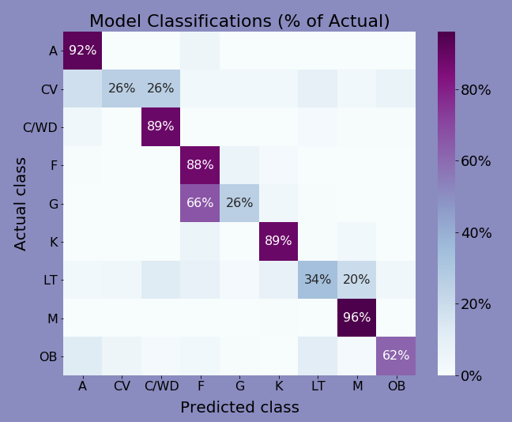
Model
For Comparison:
Decision Tree
Balanced accuracy
score:
0.67
Minority classes
Correct classifications are on the diagonal
Notes:
Some models for comparison

Slide 15
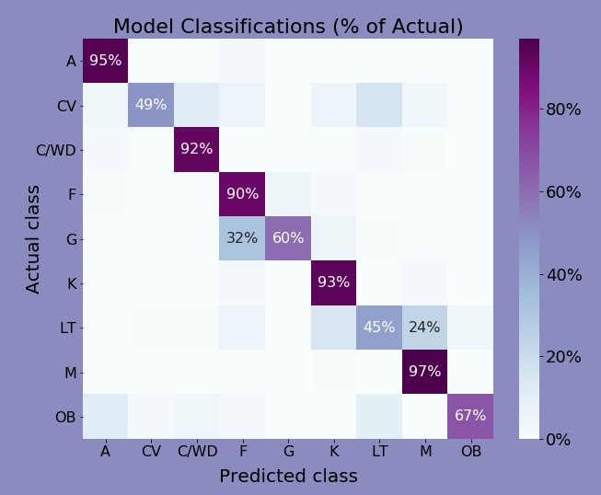
Model
For Comparison:
Random Forest
Balanced accuracy
score:
0.77
Minority classes
Correct classifications are on the diagonal
Notes:
Some models for comparison

Slide 16
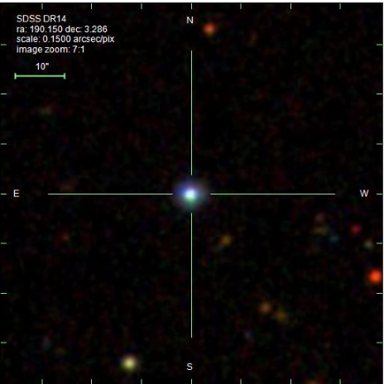
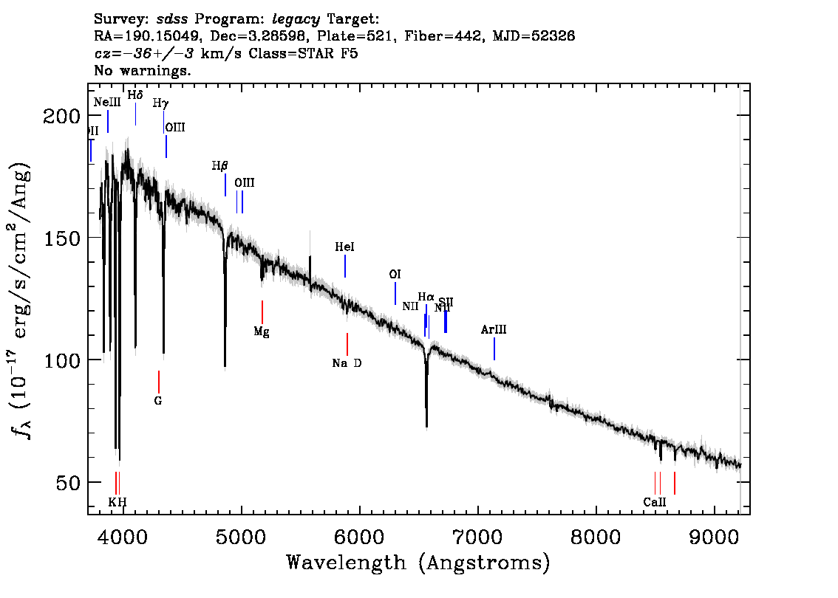
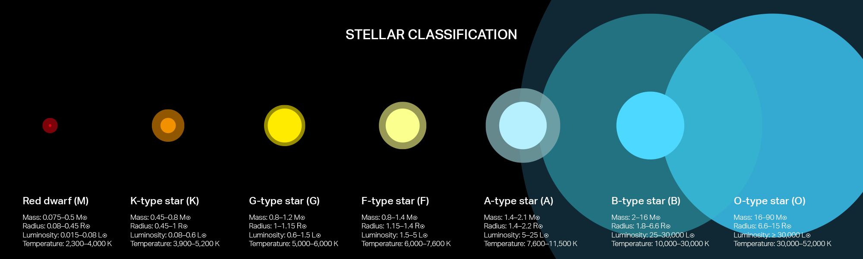
Sample Pipeline
Notes:
Let’s say we have this star
Take spectrum measuring across wavelengths
Measure intensity at specific line indices corr to elements
Feed into model to determine type

Slide 17
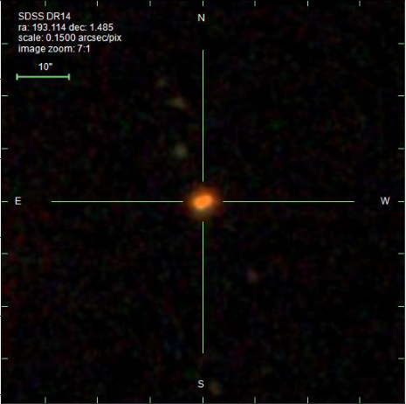
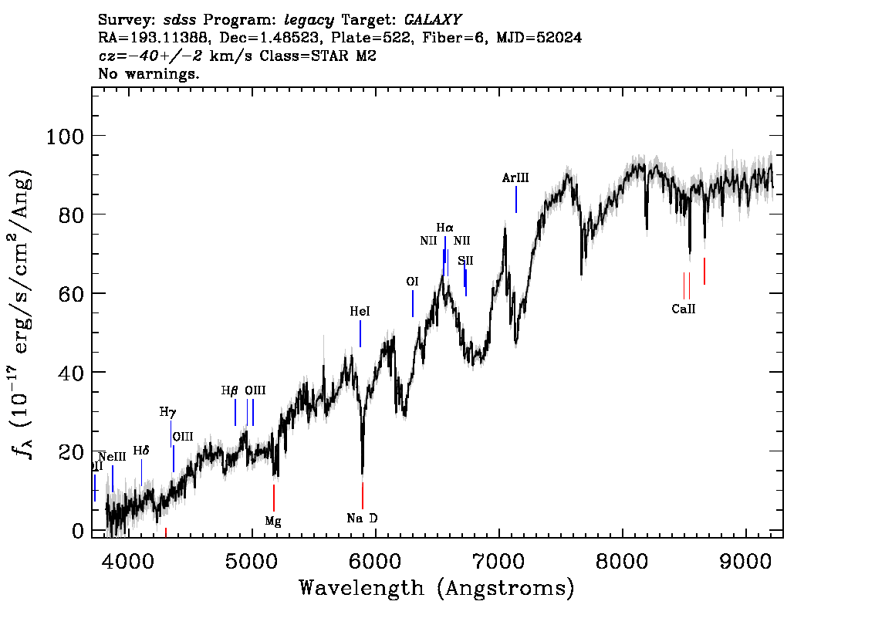
Sample Pipeline 2

Slide 18
More of the Science

Slide 19
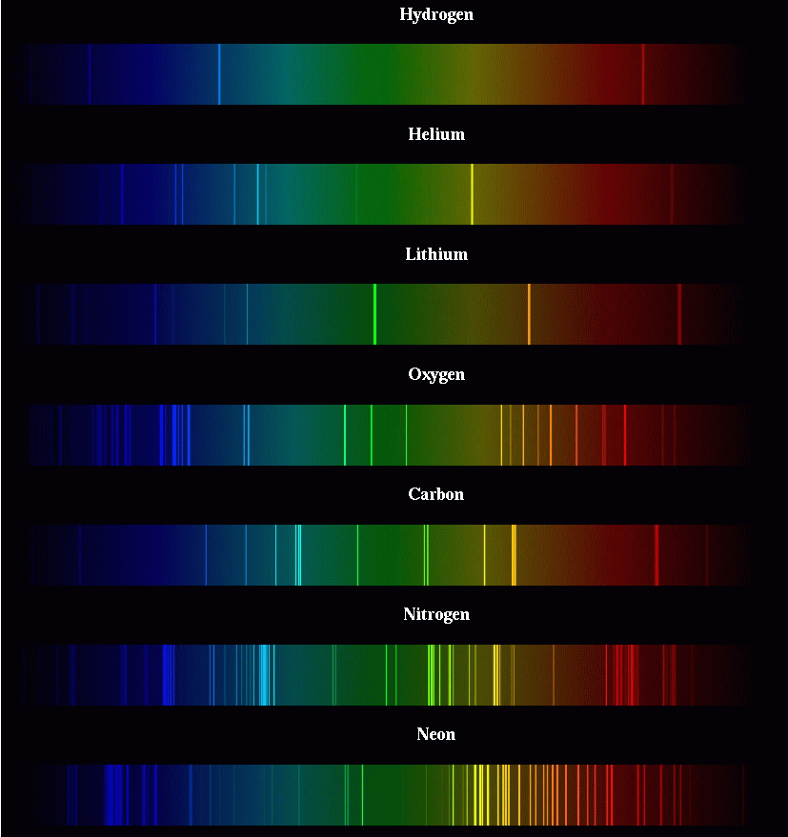
Spectrography
Different elements absorb and emit different wavelengths of light
Therefore we can determine presence of elements by looking for absorption lines (dark lines) and emission lines (bright lines)
Notes:
Pic 1: Normal stellar spectral types, pic 2: abnormal stellar spectral types, pic 3: elemental spectra, pic 4: stellar spectra

Slide 20
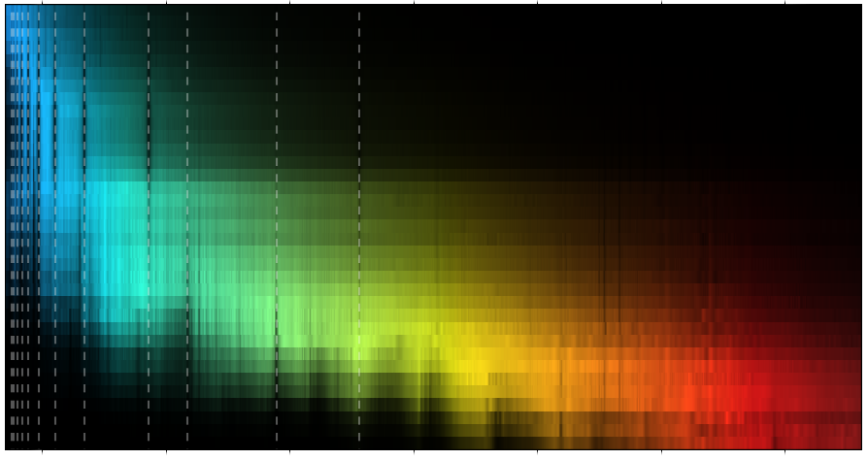
Spectrography
O
B
A
F
G
K
M
A bunch of different stellar spectra, ranging from Type O to Type M.
The different elements in these stars are causing lots of little lines.
Notes:
Pic 1: Normal stellar spectral types, pic 2: abnormal stellar spectral types, pic 3: elemental spectra, pic 4: stellar spectra

Slide 21
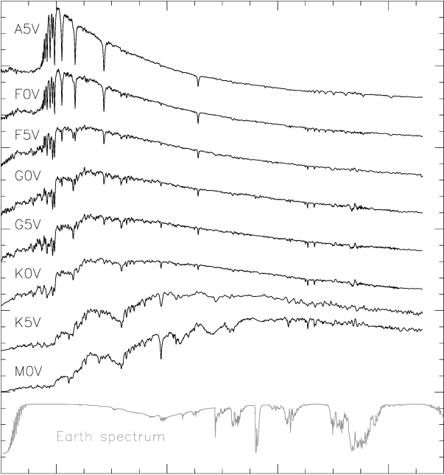
Spectrographs
These spectrographs can also be represented as graphs like these.
Those absorptions and emission lines now show up as sharp spikes or dips on the graph.
The surface temperature of the star can be determined from these graphs by looking at highest peak.
Notes:
Pic 1: Normal stellar spectral types, pic 2: abnormal stellar spectral types, pic 3: elemental spectra, pic 4: stellar spectra

Slide 22
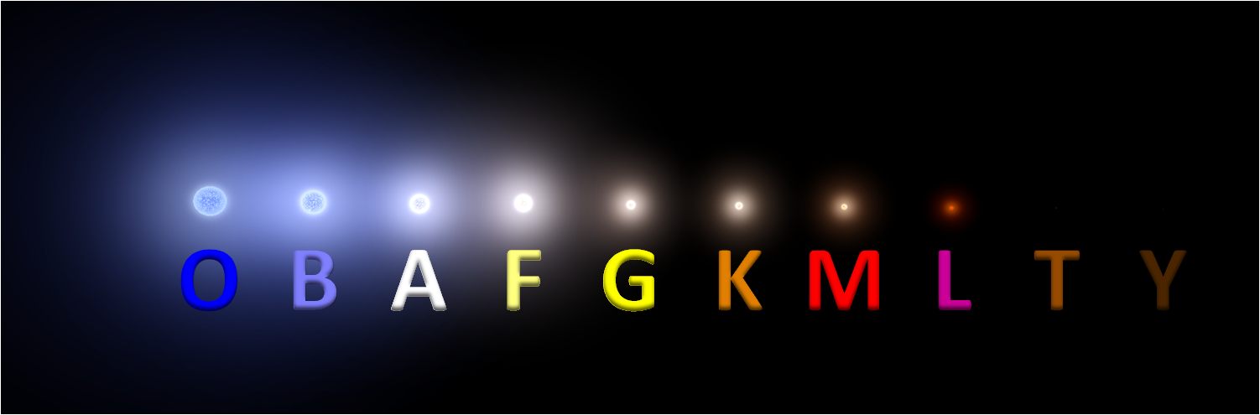
Spectral Types
Normal spectral types range from blue hypergiants in Type O to brown dwarfs in Y (which emit almost no light).
The Normal Ones

Slide 23
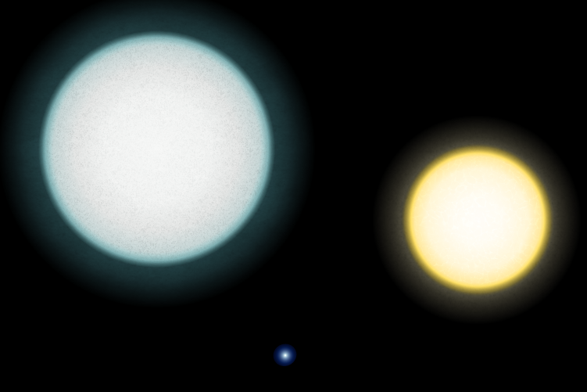

Spectral Types
But there are also abnormal spectral types, such as white dwarfs, relatively bright but very small stars
Usually these are the core of a larger star that has blown off its outer layers in a supernova
The Itsy Bitsy Ones
White Dwarf
Our
Sun

Slide 24
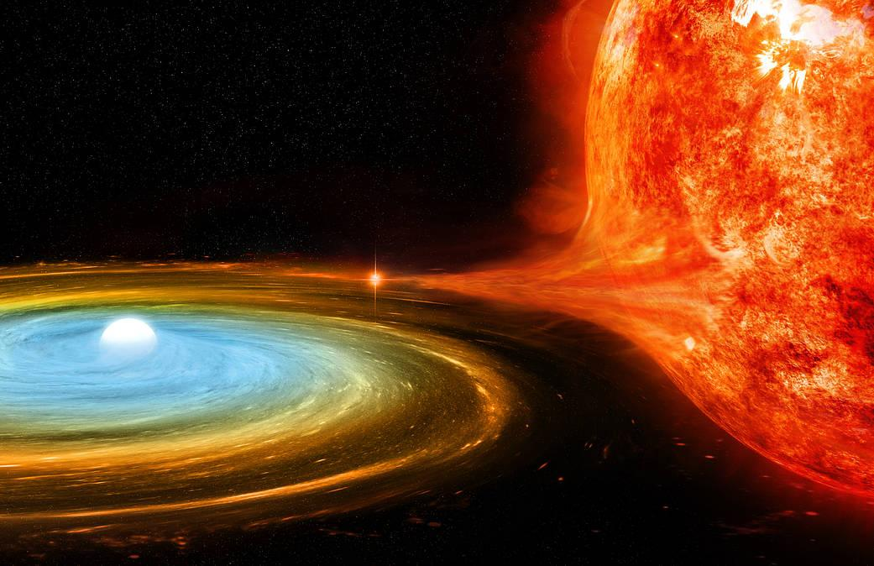
Spectral Types
Cataclysmic variable stars are a type of star that fluctuates in brightness over time. These stars only appear in binary systems
The Thieves
CV stars siphon material off of their binary companion, periodically building up layers and then blowing them off in a bright flash
Cataclysmic Variable Stars

Slide 25
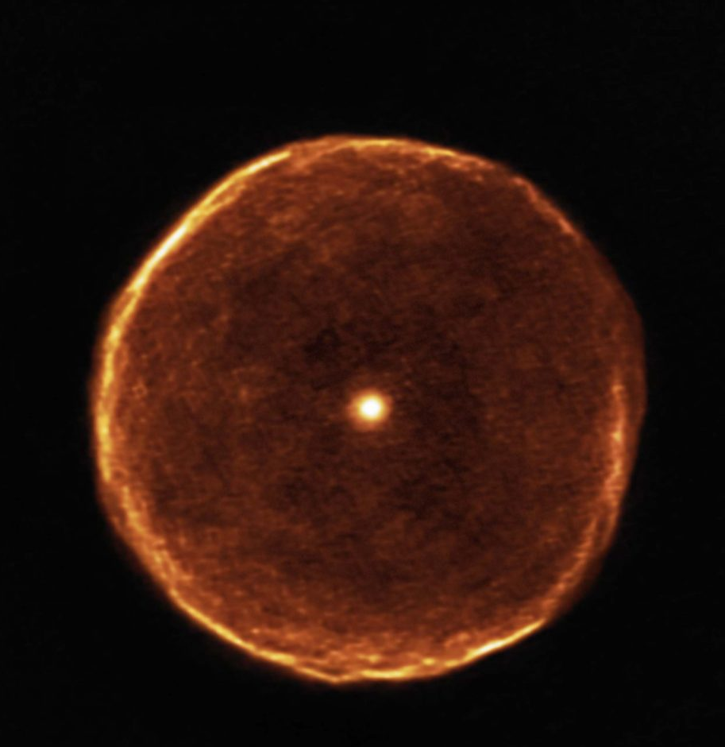
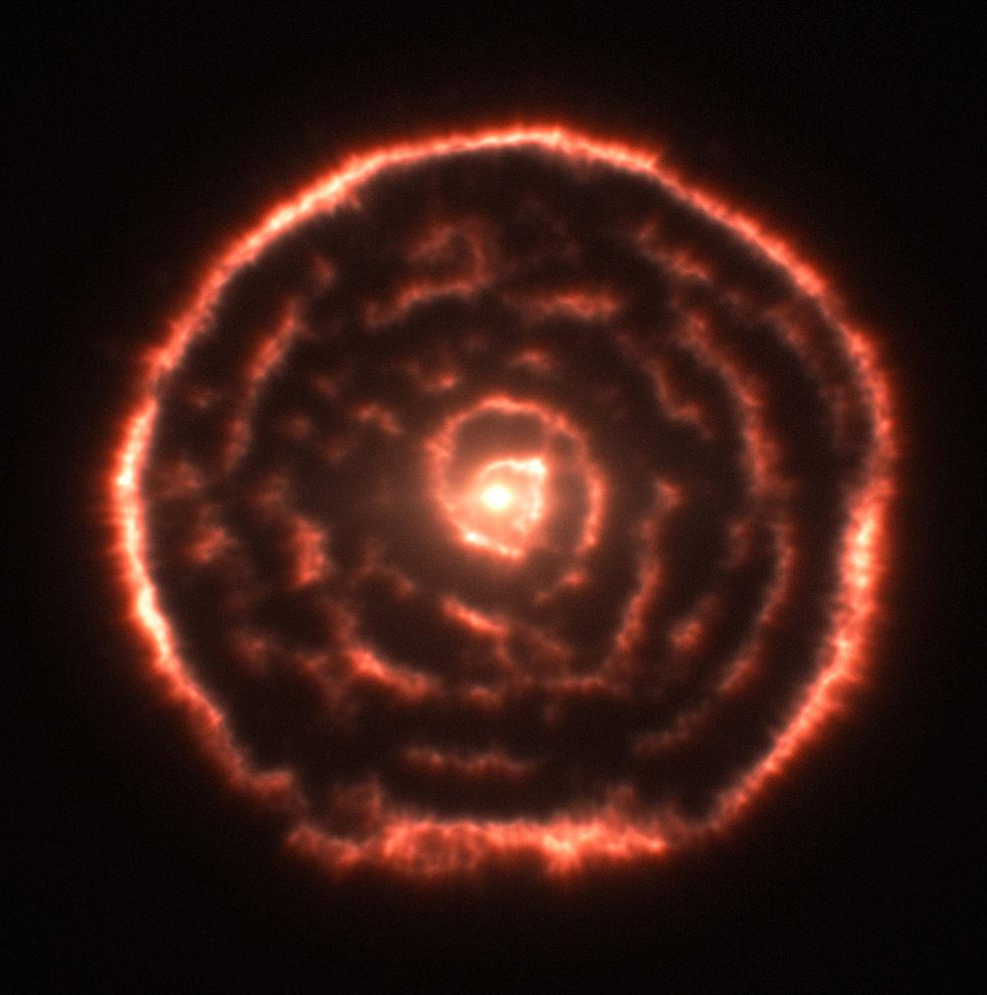
Spectral Types
The Dying Giants
Carbon Stars
Carbon stars are the faint remnants of late stage (dying) stars that didn’t have enough mass to supernova, so once fusion stops in the core, the outer layers gradually drift off

